Slide 1
University of Arizona Data Science Bootcamp
Group Project 1
Group Members:
Brenda Daly, Bryan Paynich, Anthony Mutwol, Frank Garcia

Slide 2
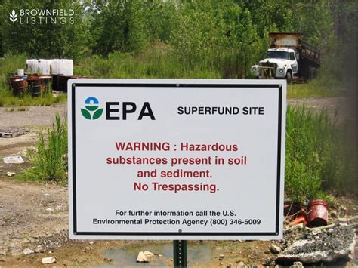
What is a Super Fund site?

Slide 3
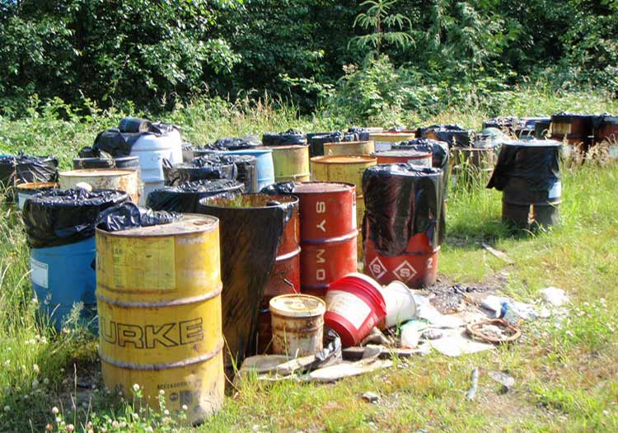

How do Superfund sites directly correlate with the top four cancers in the U.S.?
Top four cancers:
Lung Cancer
Colon Cancer
Breast Cancer
Prostate Cancer

Slide 4
Data Overview & Sources
Superfund Data
https://www.epa.gov/superfund/search-superfund-sites-where-you-live
Cancer Data for years 2011-2015
www.cancer.org
statecancerprofiles.cancer.gov/index.html
API Maps
https://maps.googleapis.com/maps/api/geocode

Slide 5
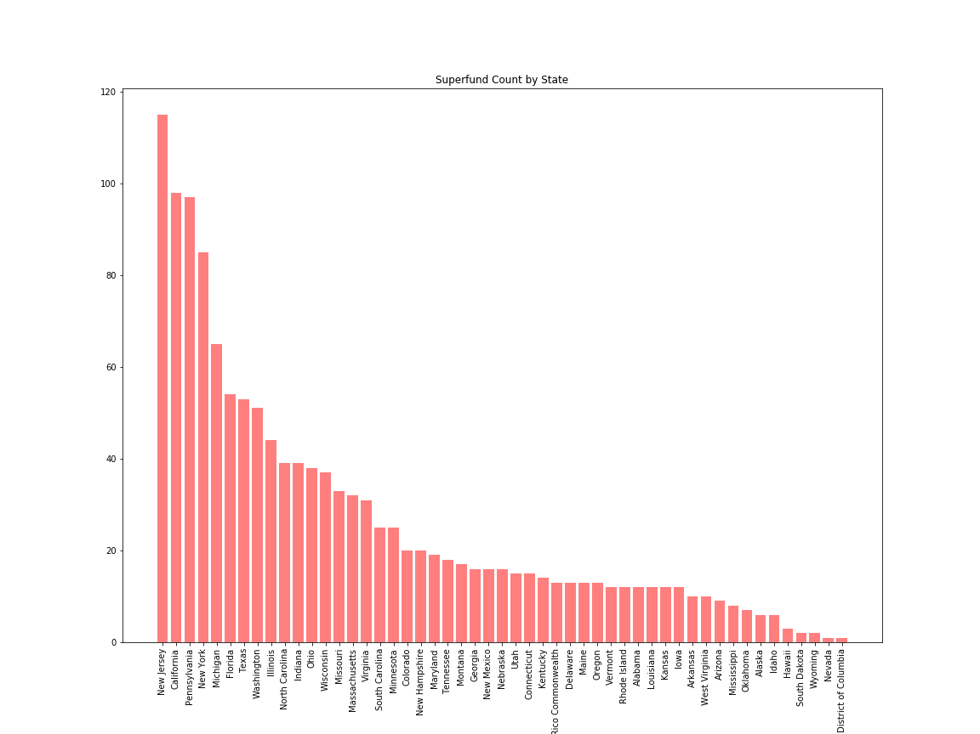
Superfund Count by State

Slide 6
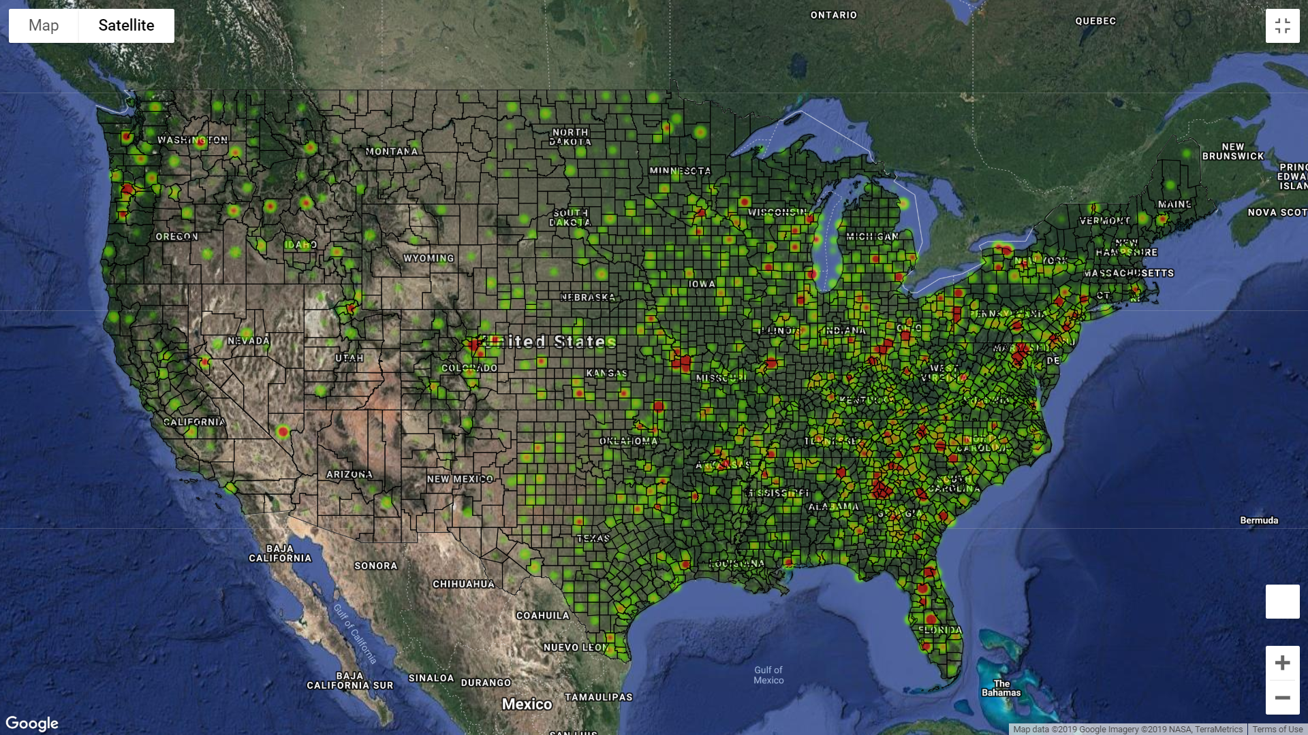
Lung Heat Map

Slide 7
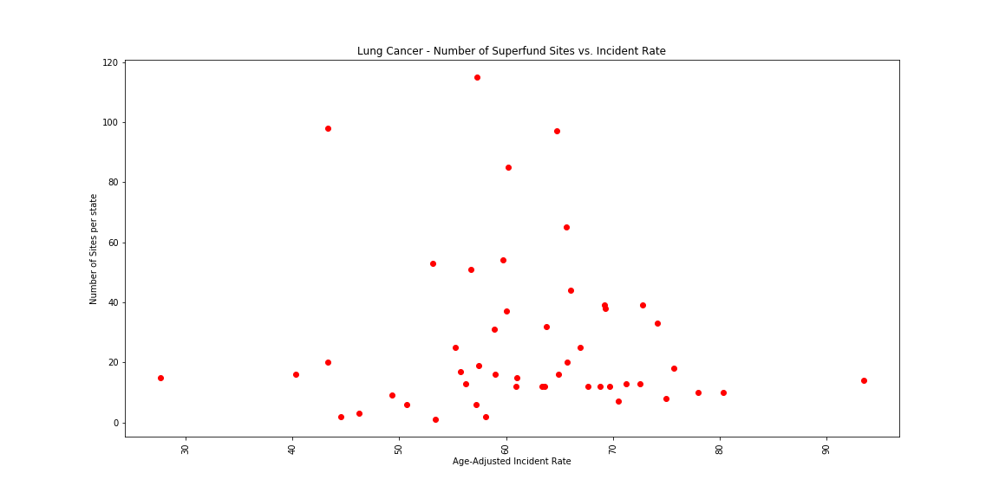
Lung Cancer

Slide 8
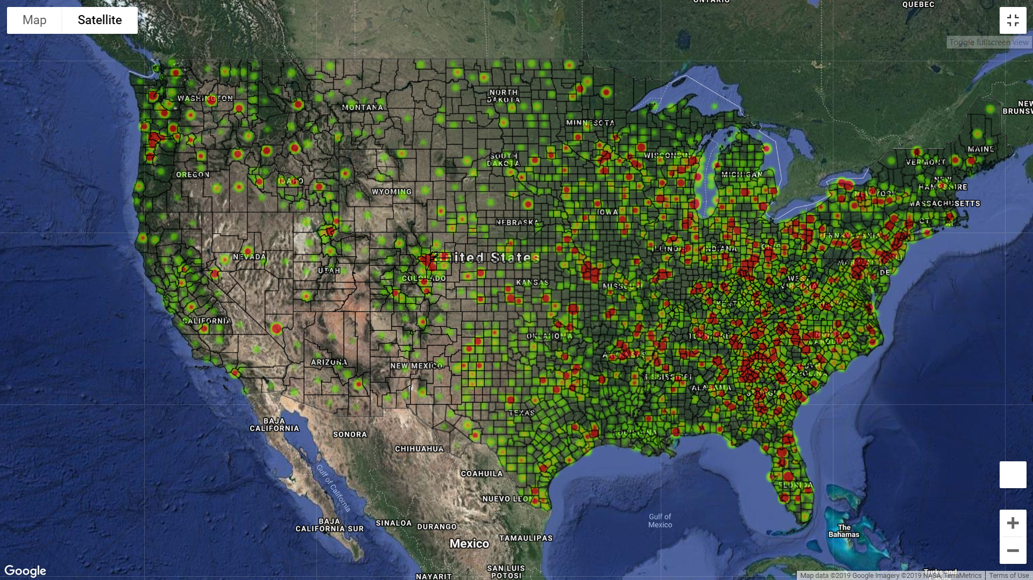
Breast Cancer Heat Map

Slide 9
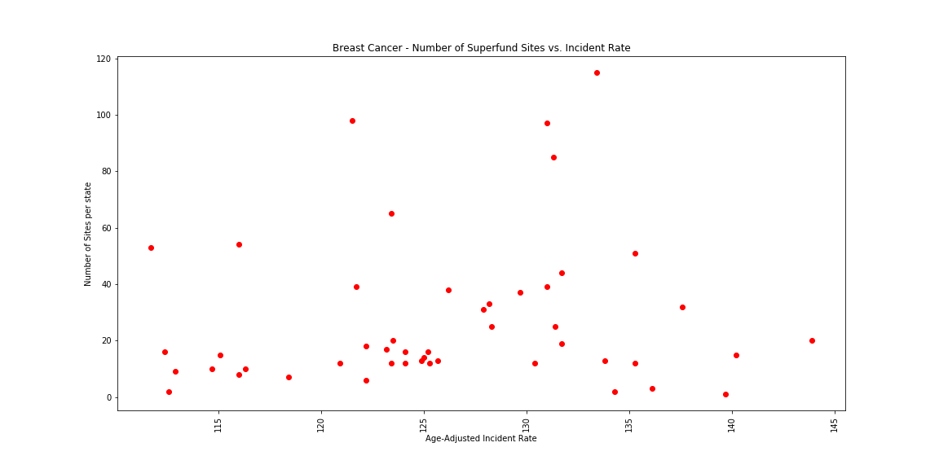
Breast Cancer

Slide 10
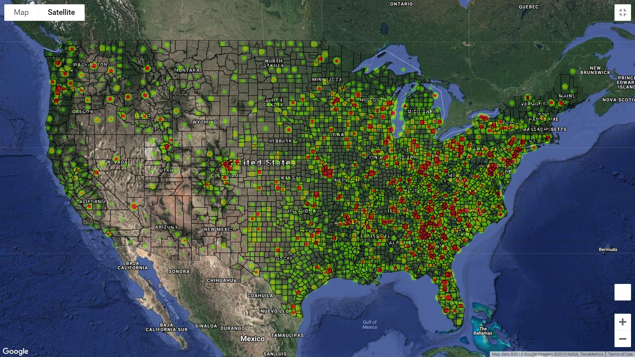
Prostate Cancer Heat Map

Slide 11
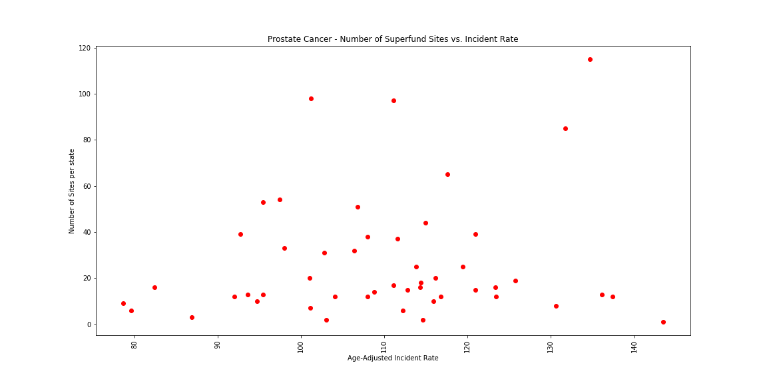
Prostate Cancer

Slide 12
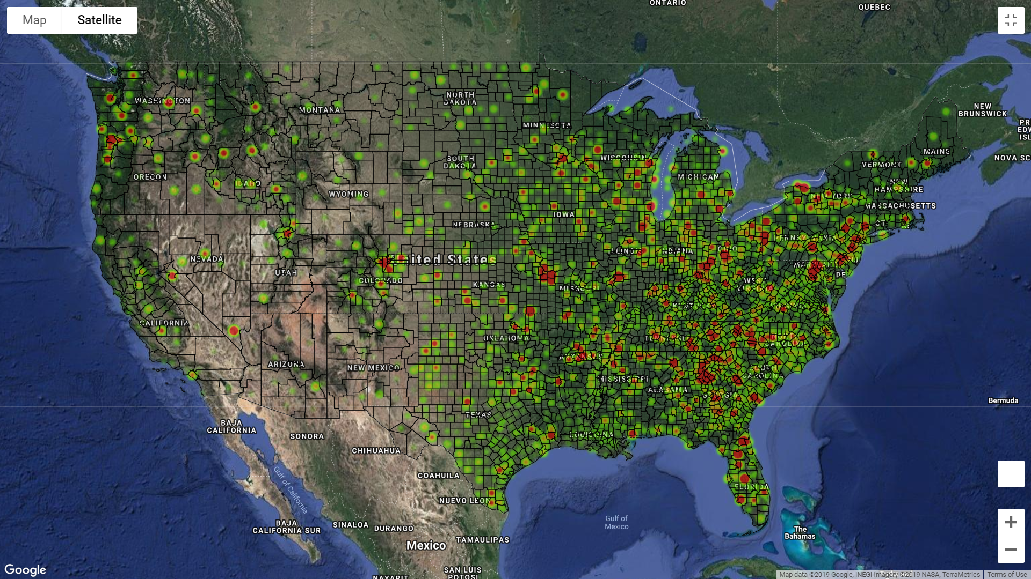
Colon Cancer Heat Map

Slide 13
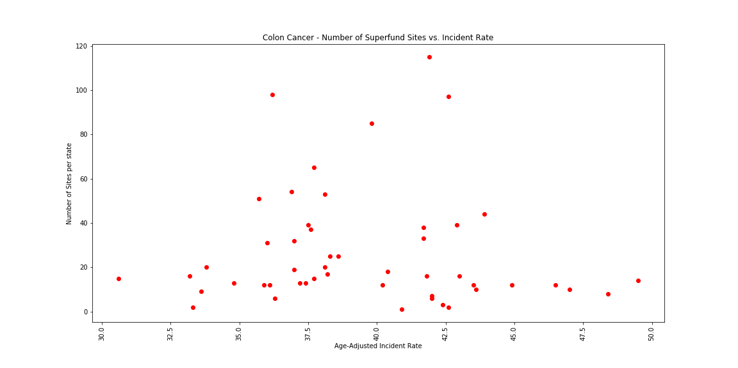
Colon Cancer

Slide 14
Top five and bottom five states of cancer incidence
Breast Cancer
New Hampshire | 143.9
District of Columbia | 139.7
Massachusetts | 137.6
Rhode Island | 135.3
South Dakota | 134.3
Arkansas | 114.7
Arizona | 112.9
Wyoming | 112.6
Texas | 111.7
Puerto Rico | 93.2
Colon & Rectum Cancer
Mississippi | 48.4
West Virginia | 47.0
North Dakota | 45.7
Illinois | 43.9
Arkansas | 43.6
Rhode Island | 35.9
Oregon | 34.8
Colorado | 33.8
Arizona | 33.6
Wyoming | 33.3
Lung & Bronchus
West Virginia | 80.3
Arkansas | 78.0
Tennessee | 75.7
Mississippi | 75.0
Missouri | 74.2
Idaho | 50.7
Arizona | 49.3
Wyoming | 44.5
Colorado | 43.3
Puerto Rico | 17.7
Prostate Cancer
Puerto Rico | 146.6
District of Columbia | 143.5
Delaware | 136.1
New York | 131.7
Mississippi | 130.6
Maine | 93.6
Indiana | 92.7
Vermont | 92.0
Alaska | 79.6
Arizona | 78.6

Slide 15
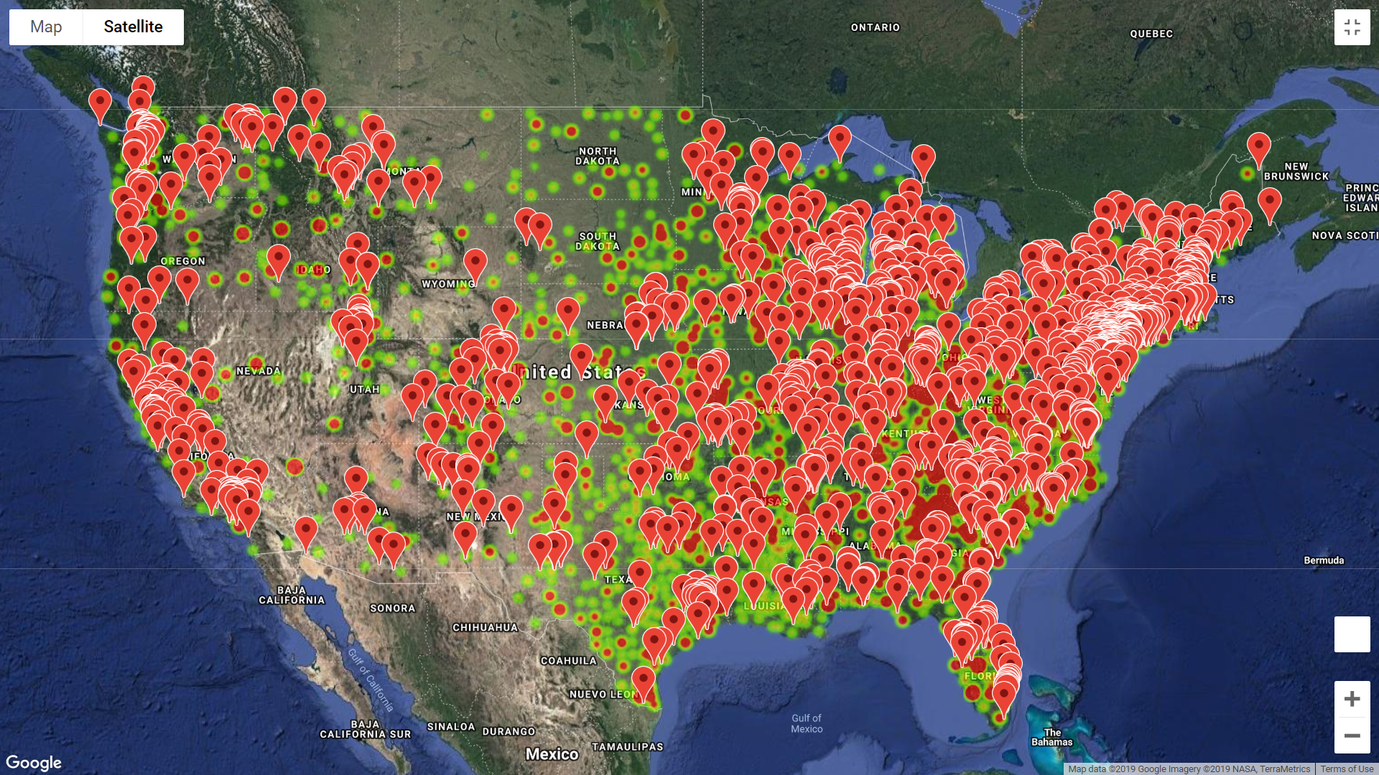
Superfund sites vs incidents of cancer

Slide 16
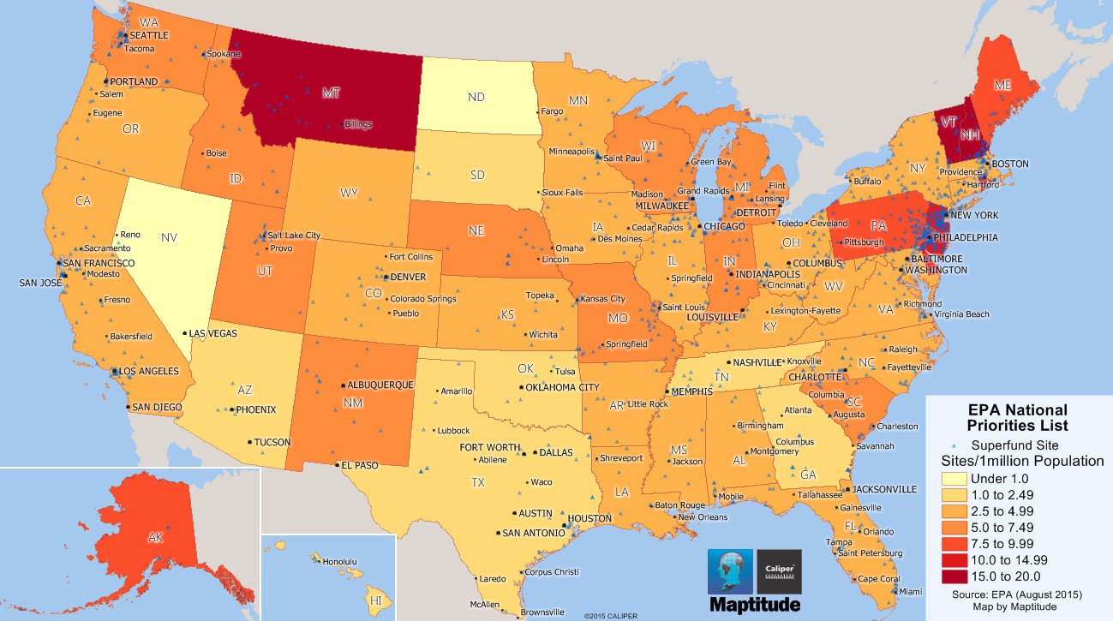
https://www.bing.com/images/search?view=detailV2&ccid=CAawJY9p&id=0FEB0C2658EB3365CB7C684F83B32834CB777B6F&thid=OIP.CAawJY9pYWg-WJVEXbstfAHaEI&mediaurl=https%3a%2f%2fwww.caliper.com%2ffeatured-maps%2fepa-superfund-site-maptitude-map.jpg&exph=725&expw=1299&q=superfund+site&simid=608031814201315119&selectedIndex=27&ajaxhist=0

Slide 17
Conclusions

